Slide 1

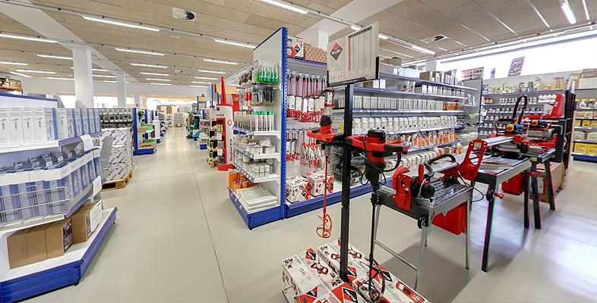
MAGADH MAHILA COLLEGE
ELECTRICAL STORE MANAGEMENT SYSTEM
Presented by
Guided by
Ankita (Roll no-40114)
Ankita Kumari (Roll no-40115)
Rishika Raj(Roll no-40139)
Mr. Kuldeep Sharma
(DBA) of NBPDCL
Submitted for the partial fulfillment
of
3yrs Vocational degree course
in
Computer Application
Department of Computer Application

Slide 2
Content
Abstract
Introduction
Objectives
Existing System
Proposed System
Software & Hardware Requirement Specification
Database Table
Applications(Screenshots)
Conclusion
Future scope
Electrical Store Management System
2

Slide 3
1. Abstract
Electrical Store Management System is a system which will help the owner of the electronic equipment shops to carry out the day-to-day businesses in a smooth and organized way. This system is developed specifically to ease the needs of the department of sales and purchase. This application shall also have some features like profit loss reports displaying in same window .It will be having user friendly GUIs that will guide the user to easily achieve the same. This will be one of the interesting projects that one can work on and implement in real time and implement. In addition to this the application also supports feature to generate different kinds of reports.
Electrical Store Management System
3

Slide 4
2. Introduction
Electrical Store Management System is a software project that serves the operation of the department of sales and purchase.
Electrical Store Management is a workable application for retail store inventory and accounts management.
This system allow user’s to login and new user’s to register on the application.
All the data is logged in the database and the user is given a login-ID.
This system helps sellers or retailers in management of storing details of customer, also keeping a list of stocks and products of a store and can do operations on them.
Electrical Store Management System
4

Slide 5
3. Objectives
The main objective of the proposed system would be to overcome the limitations of the problem faced under manual system.
Also the purpose of the proposed system is to achieve the efficient management of data.
Electrical Store Management System
5

Slide 6
4. Existing System
In the existing system, there is a lot of paper work.
It is very time consuming and uneconomical as most of the works include manual processing.
The records are difficult to store in manual system ,and it require more manual labour work.
Electrical Store Management System
6

Slide 7
5. PROPOSED SYSTEM
In this electrical store management system , everything is system- based ; there is no need of paper or pan.
It provides the user- friendly environment, so that the user can use system without much difficulty and training.
The system provide various report correctly and quickly.
This will reduce the manual processing.
This overall increases management productivity, and prove to be very economical in the long run.
Electrical Store Management System
7

Slide 8
6. Software & Hardware Requirements
SOFTWARE REQUIREMENT
Frontend MS Visual Basic 6.0
Backend SQL
Database MS ACCESS
HARDWARE REQUIREMENT
RAM 4.00 GB
Hard Disk 1TB
Monitor 32’’
Processor speed 3.30GHZ
Electrical Store Management System
8

Slide 9
7. DataBase Tables
STRUCTURE OF CART TABLE
FIELD NAME | FIELD TYPE | FIELD LENGTH | FIELD DESCRIPTION | AUTO GENERATE
PRODUCTNAME | TEXT | 50 | PRODUCT NAME | FALSE
BRANDNAME | TEXT | 50 | PRODUCT BRAND | FALSE
PRODUCTDETAIL | TEXT | 50 | PRODUCT DETAILS | FALSE
QUANTITY | INTEGER | 2 | QUANTITY OF PRODUCT | FALSE
RATE | INTEGER | 2 | RATE OF PRODUCT | FALSE
AMOUNT | INTEGER | 2 | TOTAL AMOUNT | FALSE
CUSTOMERID | TEXT | 50 | CUSTOMER ID | FALSE
ORDERID | LONG | 4 | ORDER ID | TRUE
Electrical Store Management System
9

Slide 10
STRUCTURE OF PRODUCT TABLE
FIELD NAME | FIELD TYPE | FIELD LENGTH | FIELD DESCRIPTION | AUTO GENERATE
BRAND NAME | TEXT | 50 | PRODUCT BRAND | FALSE
PRODUCTNAME | TEXT | 50 | PRODUCT NAME | FALSE
PRICE | TEXT | 50 | PRICE OF PRODUCT | FALSE
STOCK | TEXT | 50 | TOTAL PRODUCT | FALSE
DETAIL | TEXT | 50 | DETAILS OF PRODUCT | FALSE
PHOTO | MEMO | 0 | PHOTO OF PRODUCT | FALSE
Electrical Store Management System
10

Slide 11
STRUCTURE OF SELLER TABLE
FIELD NAME | FIELD TYPE | FIELD LENGTH | FIELD DESCRIPTION | AUTO GENERATE
ID | LONG | 4 | SELLER ID | FALSE
NAME | TEXT | 50 | NAME OF SELLER | FALSE
ADDRESS | TEXT | 200 | ADDRESS OF SELLER | FALSE
CONTACTNO | TEXT | 10 | CONTACT NUMBER | FALSE
EMAIL | TEXT | 50 | EMAIL ADDRESS | FALSE
AADHARNO | TEXT | 20 | AADHAR NUMBER | FALSE
PANNO | TEXT | 25 | PAN NUMBER | FALSE
PHOTO | MEMO | 0 | PHOTO OF SELLER | FALSE
PASSWORD | TEXT | 50 | PASSWORD | FALSE
STRUCTURE OF PAYMENT TABLE
FIELD NAME | FIELD TYPE | FIELD LENGTH | FIELD DESCRIPTION | AUTO GENERATE
CUSTOMERID | TEXT | 25 | CUSTOMER ID | FALSE
INVOICENO | LONG | 4 | INVOICE NUMBER | FALSE
PAIDAMOUNT | INTEGER | 2 | AMOUNT PAID | FALSE
DELIVERYADDRESS | TEXT | 150 | DELIVERY ADDRESS | FALSE
DATE | DATE/TIME | 8 | DATE | FALSE
PAYMENTMODE | TEXT | 50 | PAYMENT MODE | FALSE
Electrical Store Management System
11

Slide 12
STRUCTURE OF CUSTOMER TABLE
FIELD NAME | FIELD TYPE | FIELD LENGTH | FIELD DESCRIPTION | AUTO GENERATE
CUSTOMERID | LONG | 4 | CUSTOMER ID | TRUE
NAME | TEXT | 50 | NAME OF CUSTOMER | FALSE
ADDRESS | TEXT | 250 | ADDRESS | FALSE
DISTRICT | TEXT | 25 | DISTRICT | FALSE
STATE | TEXT | 25 | STATE | FALSE
PINCODE | TEXT | 10 | PINCODE | FALSE
CONTACTNO | TEXT | 10 | CONTACT NUMBER | FALSE
PANNO | TEXT | 25 | PAN NUMBER | FALSE
AADHARNO | TEXT | 20 | AADHAR NUMBER | FALSE
EMAIL | TEXT | 50 | EMAIL ADDRESS | FALSE
PASSWORD | TEXT | 50 | PASSWORD | FALSE
PHOTO | MEMO | 0 | CUSTOMER IMAGE | FALSE
PAN | MEMO | 0 | PAN IMAGE | FALSE
AADHAR | MEMO | 0 | AADHAR IMAGE | FALSE
CONFIRMPASSWORD | TEXT | 50 | CONFIRM PASSWORD | FALSE
Electrical Store Management System
12

Slide 13
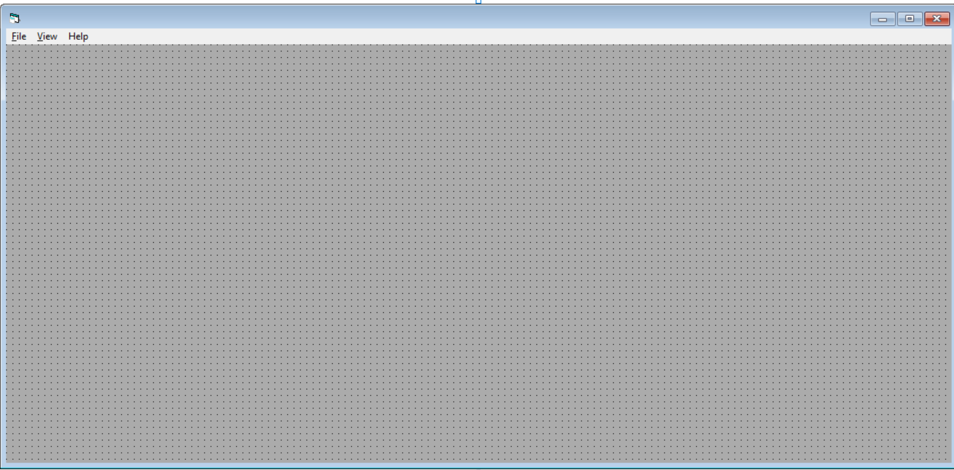
8.Applications(Screenshots)
Electrical Store Management System
13

Slide 14
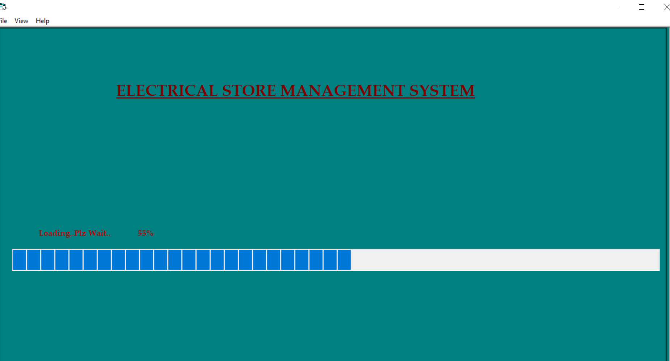
Welcome Form
Electrical Store Management System
14

Slide 15
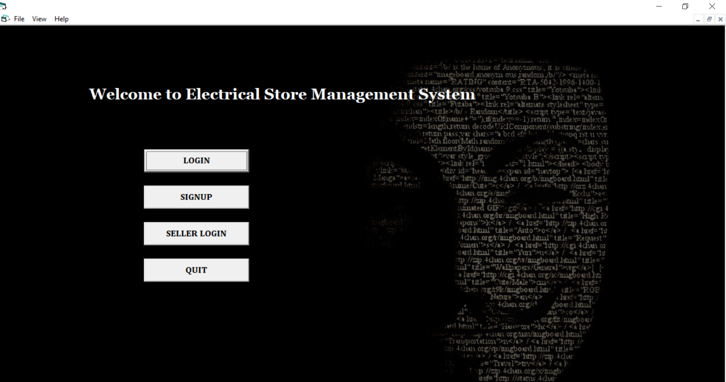
Start UP Form
Electrical Store Management System
15

Slide 16
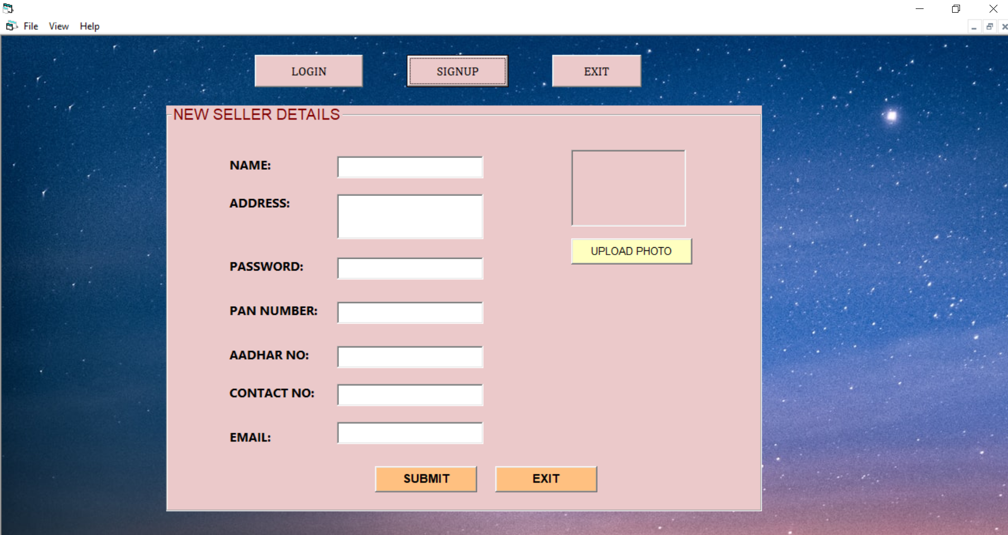
Seller Sign UP Form
Electrical Store Management System
16

Slide 17
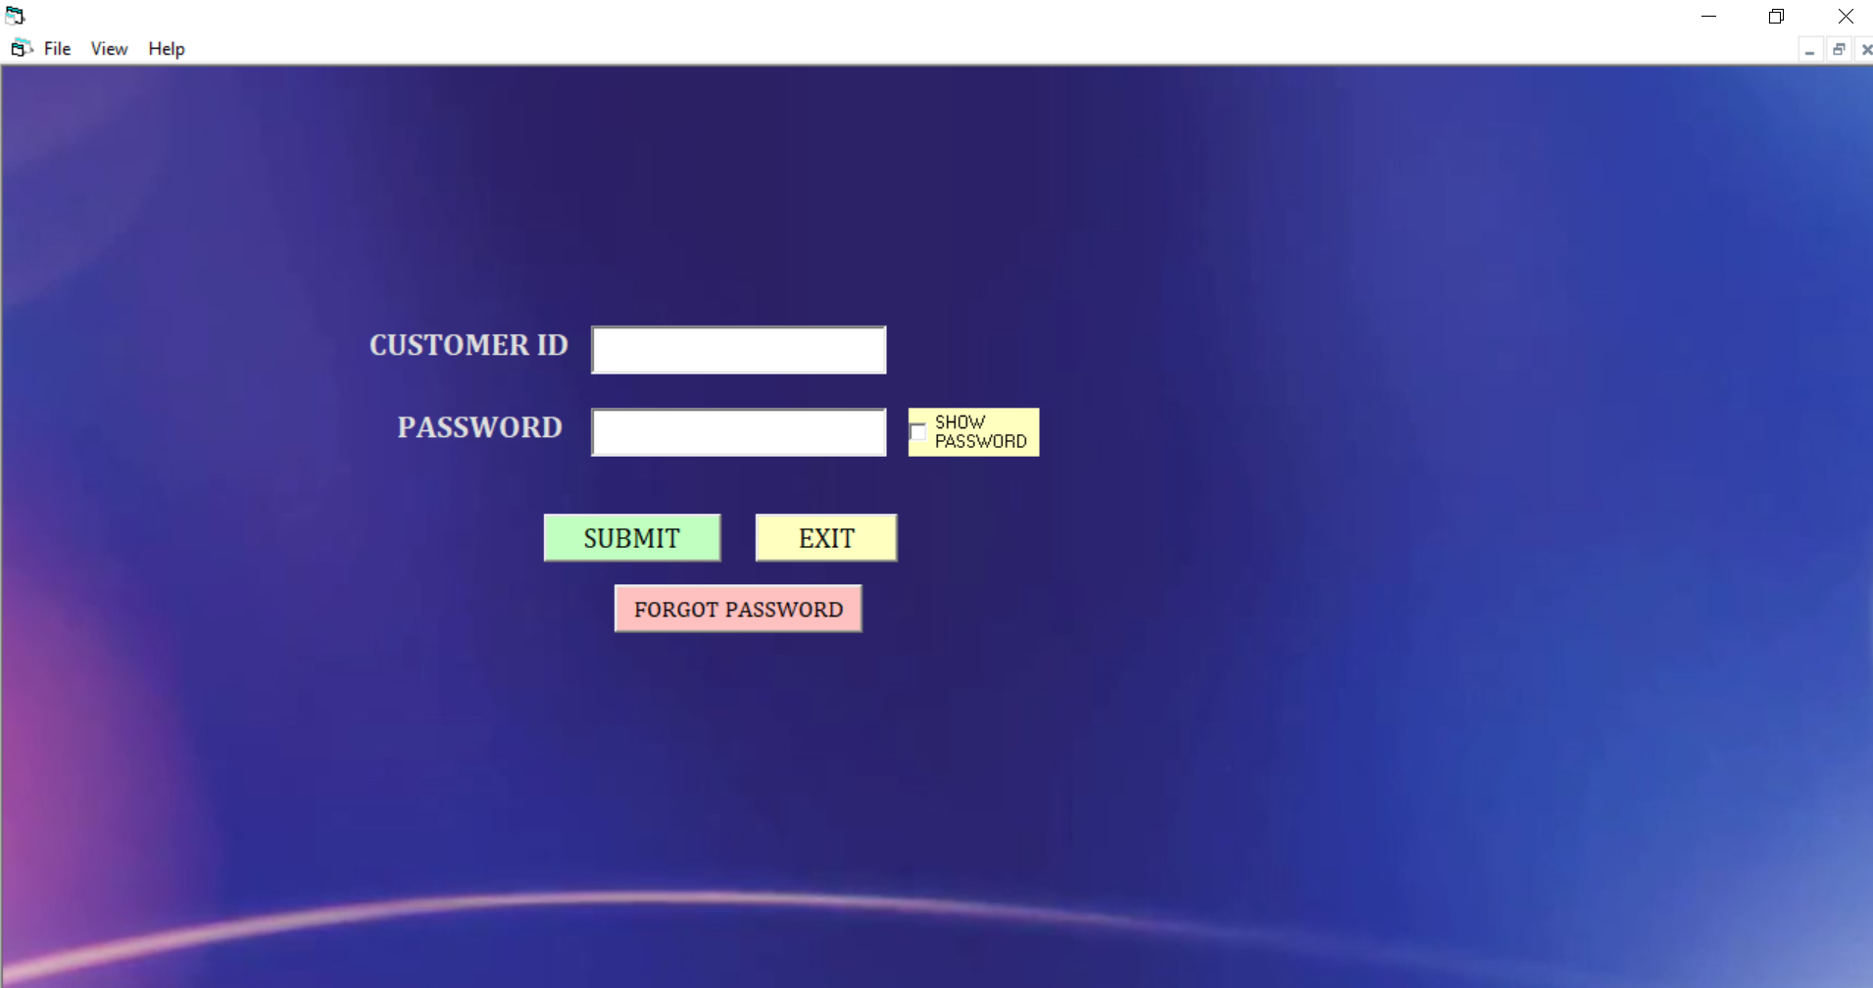
Login Form
Electrical Store Management System
17

Slide 18
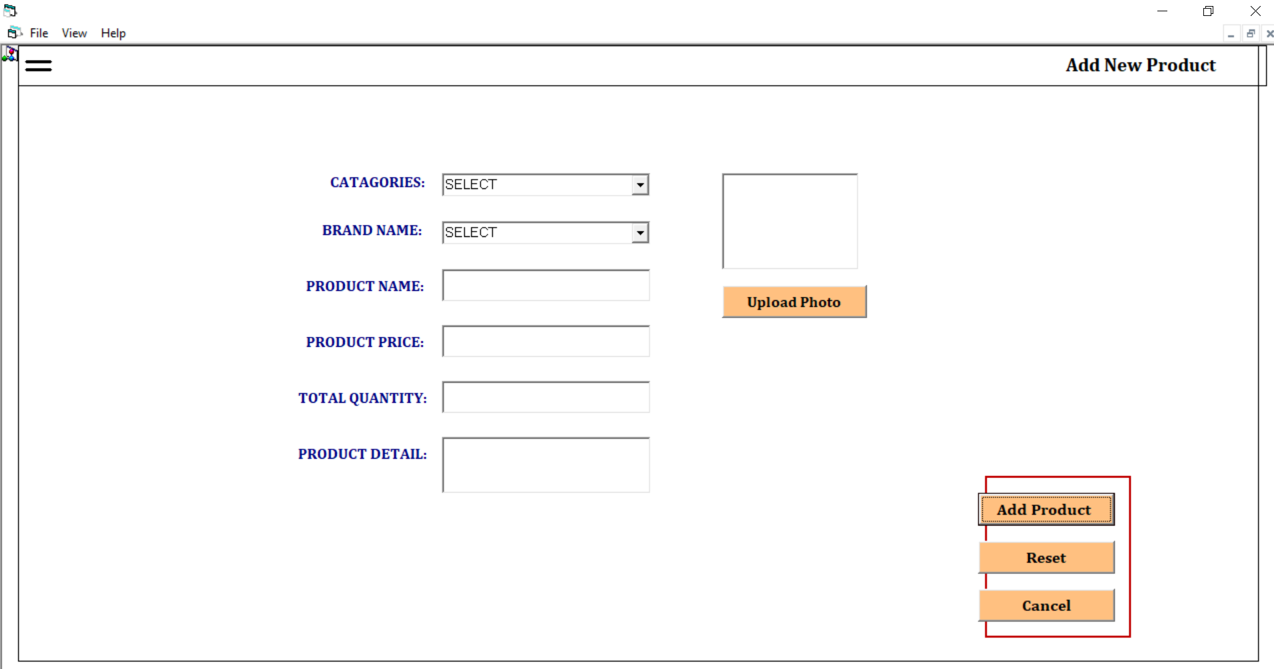
Add New Product Form
Electrical Store Management System
18

Slide 19
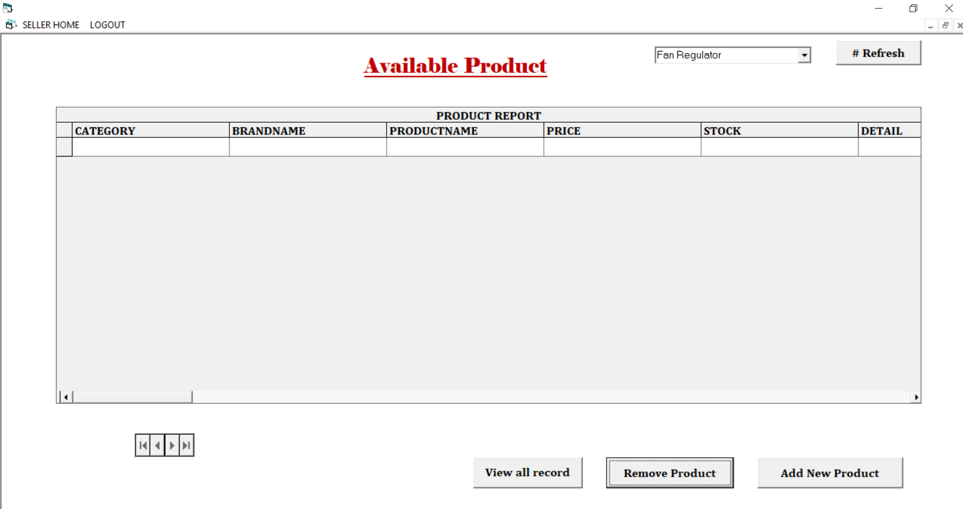
Available Product Form
Electrical Store Management System
19

Slide 20
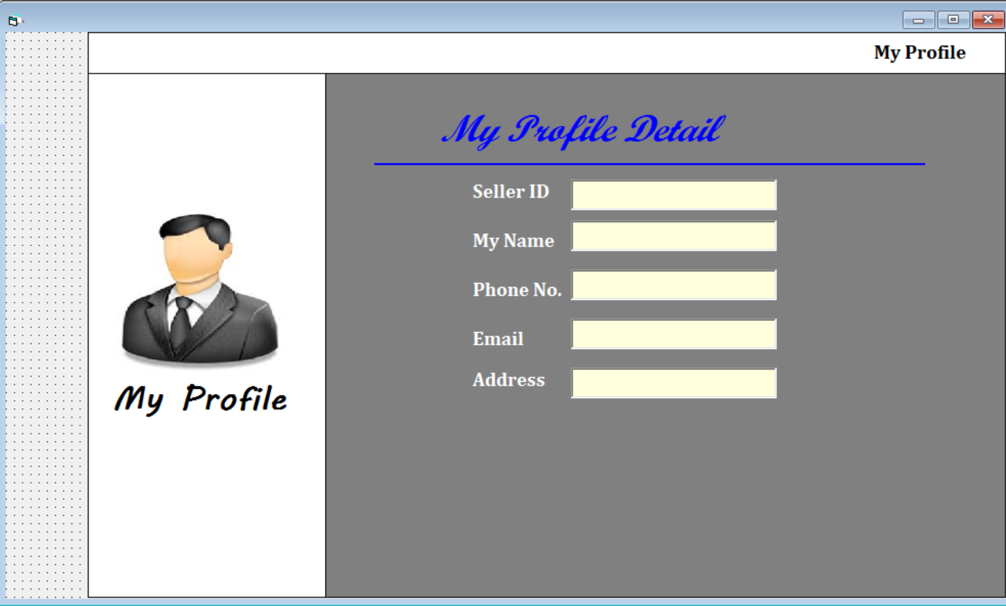
Seller Profile
Electrical Store Management System
20

Slide 21
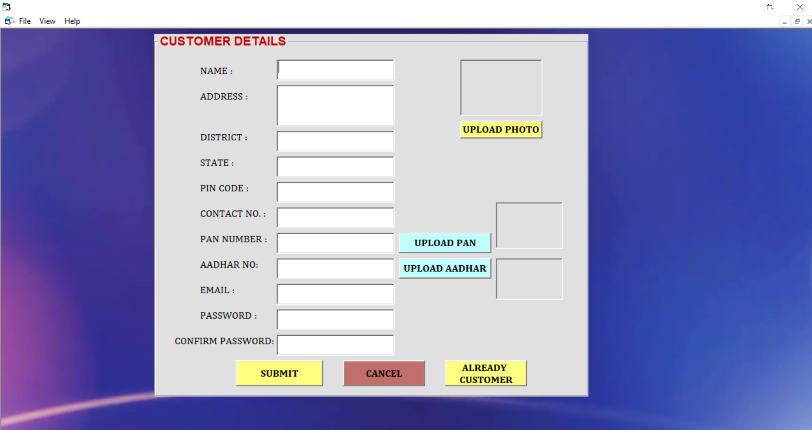
Customer Sign UP Form
Electrical Store Management System
21

Slide 22
Login Form
Electrical Store Management System
22

Slide 23
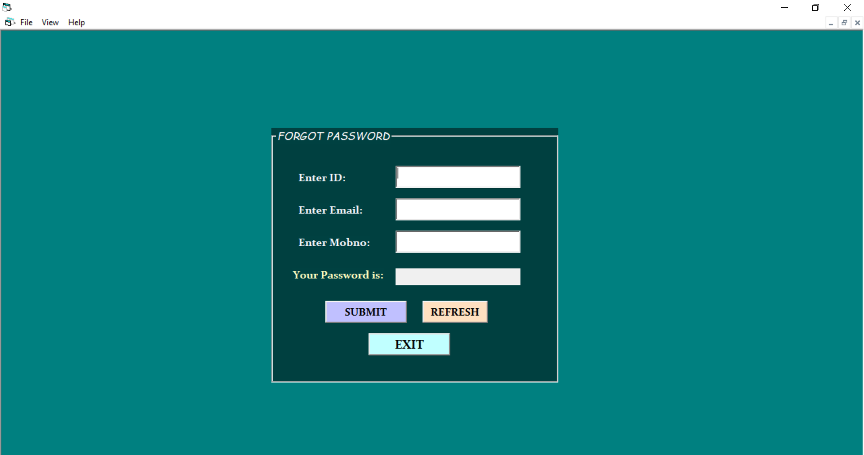
Forgot Password Form
Electrical Store Management System
23

Slide 24
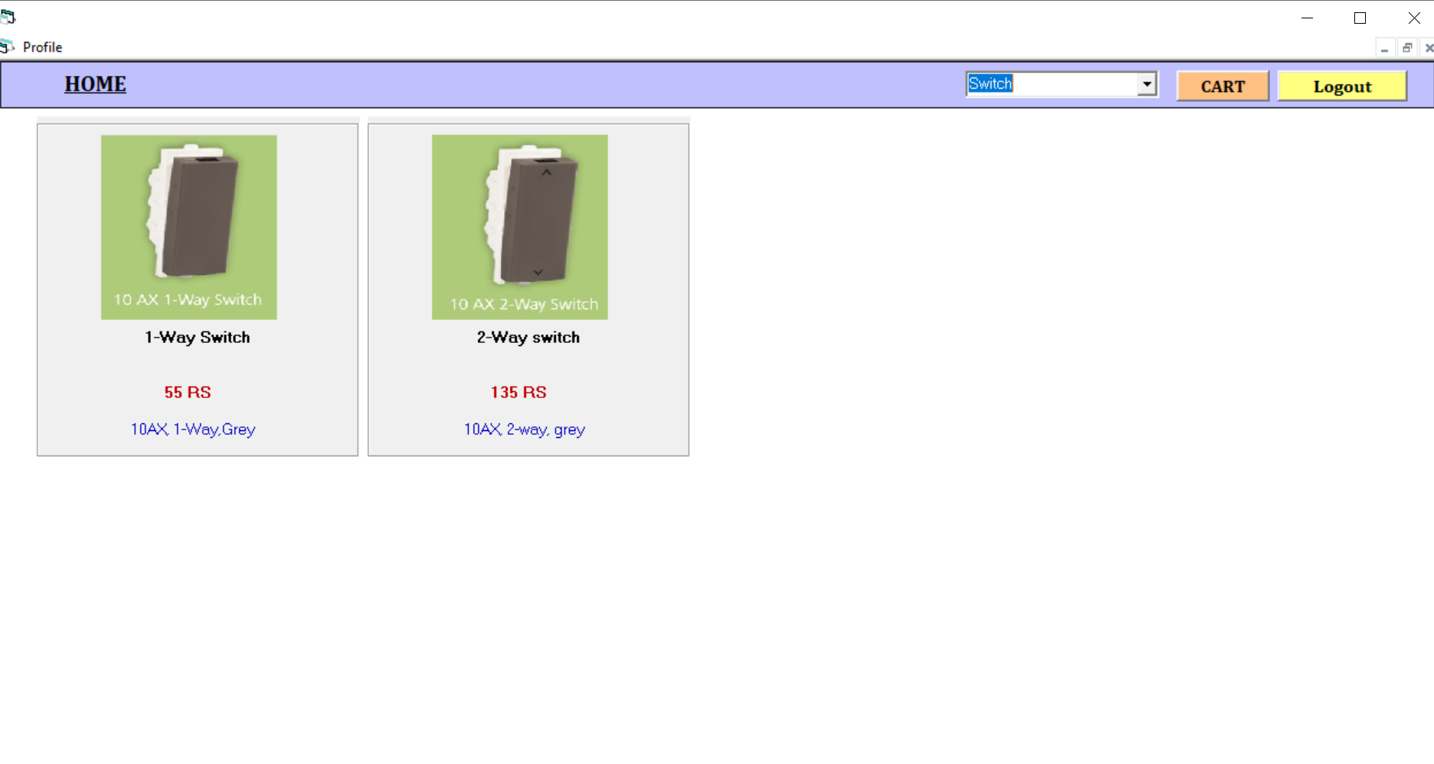
Home Form
Electrical Store Management System
24

Slide 25
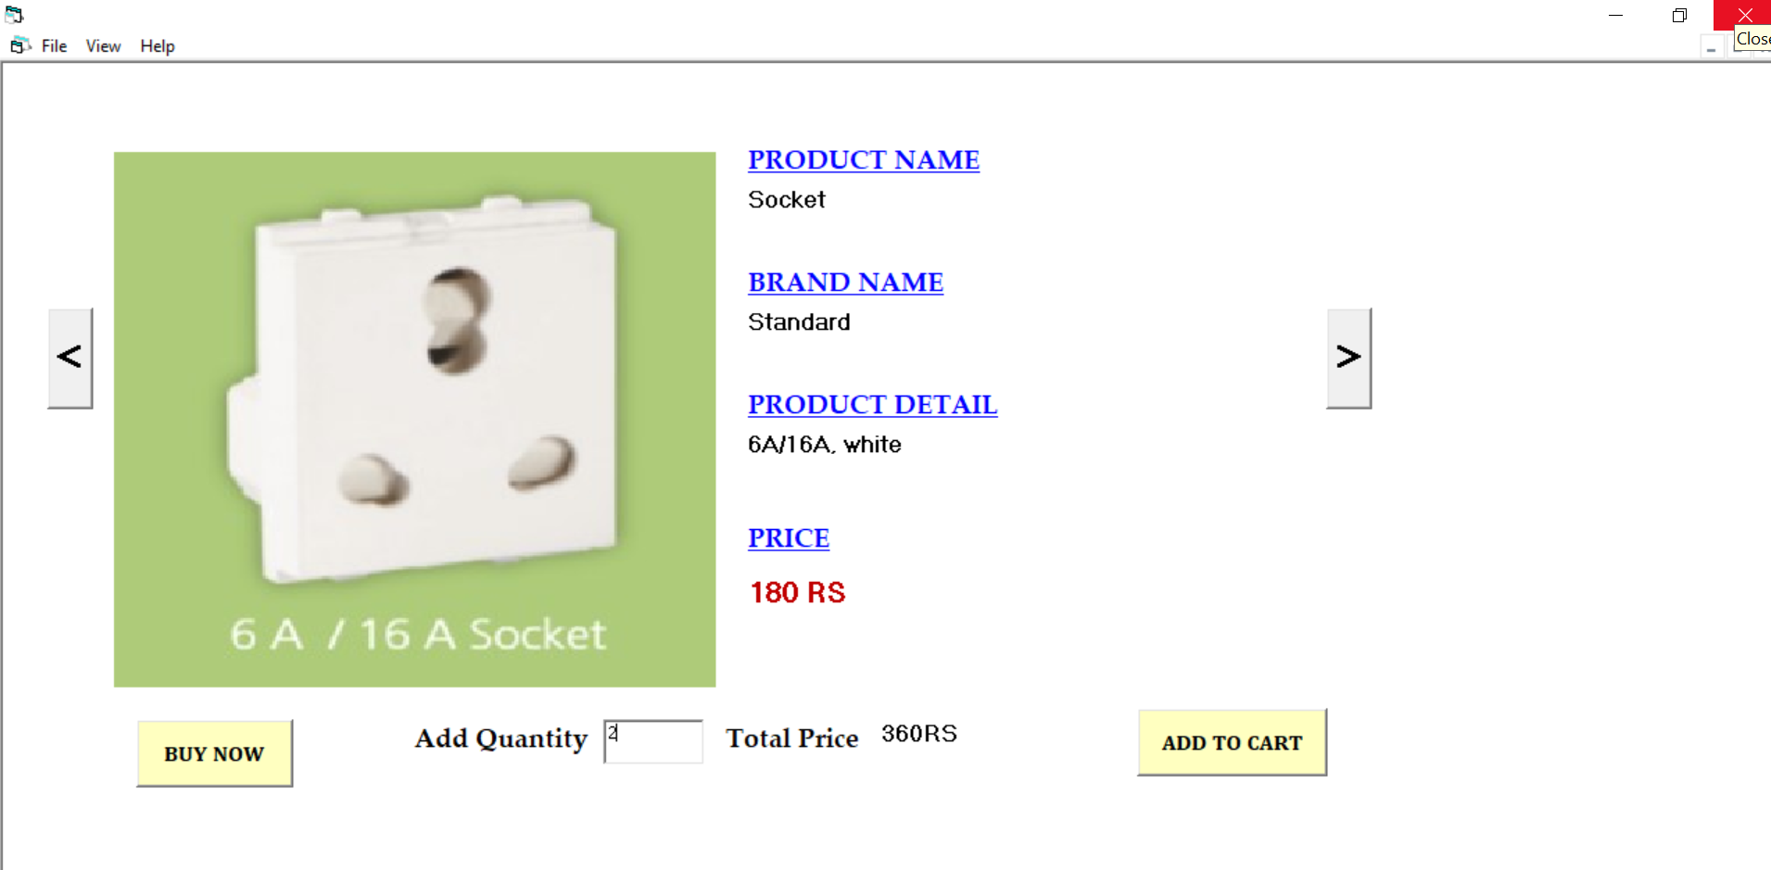
Order Form
Electrical Store Management System
25

Slide 26
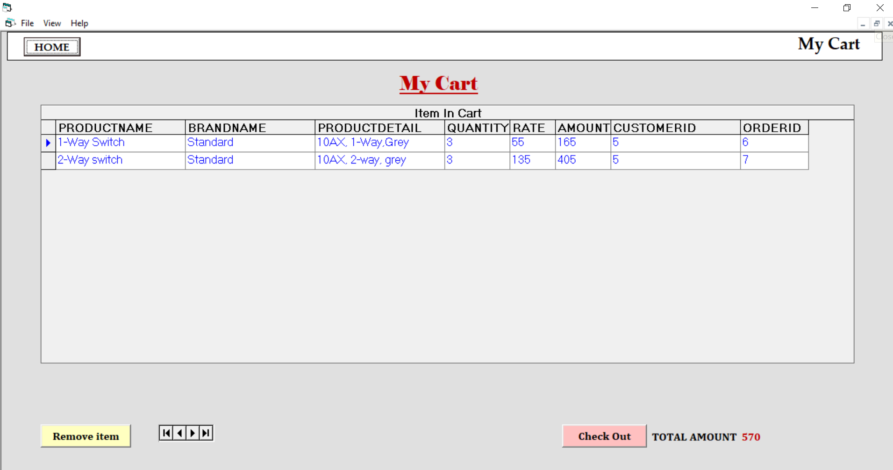
Cart Form
Electrical Store Management System
26

Slide 27
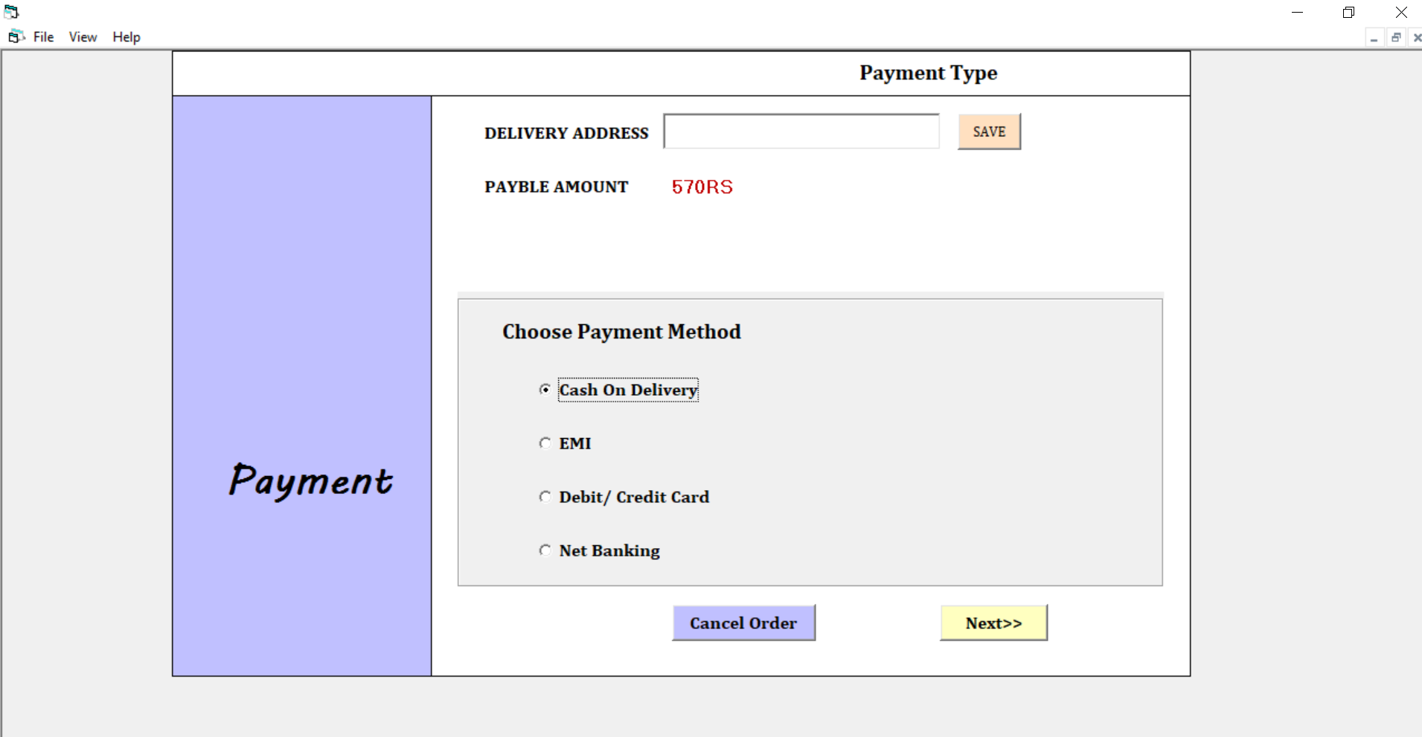
Payment Form
Electrical Store Management System
27

Slide 28
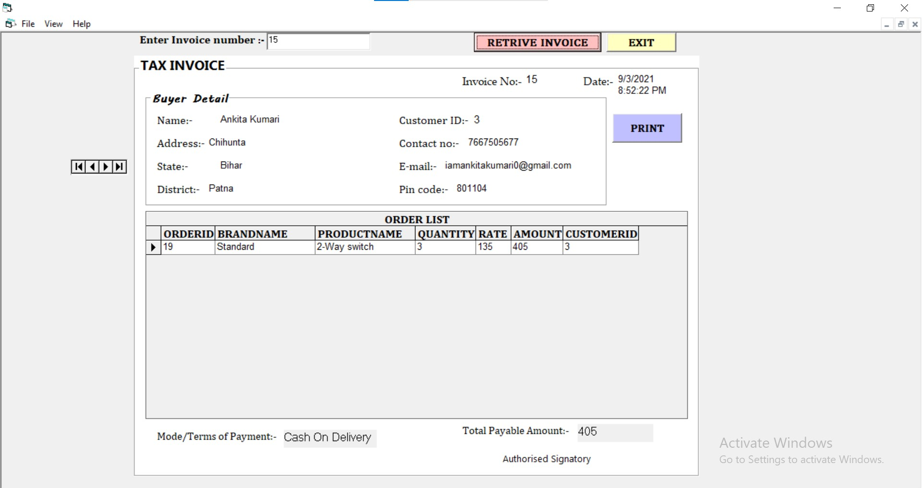
Retrieve Invoice
Electrical Store Management System
28

Slide 29
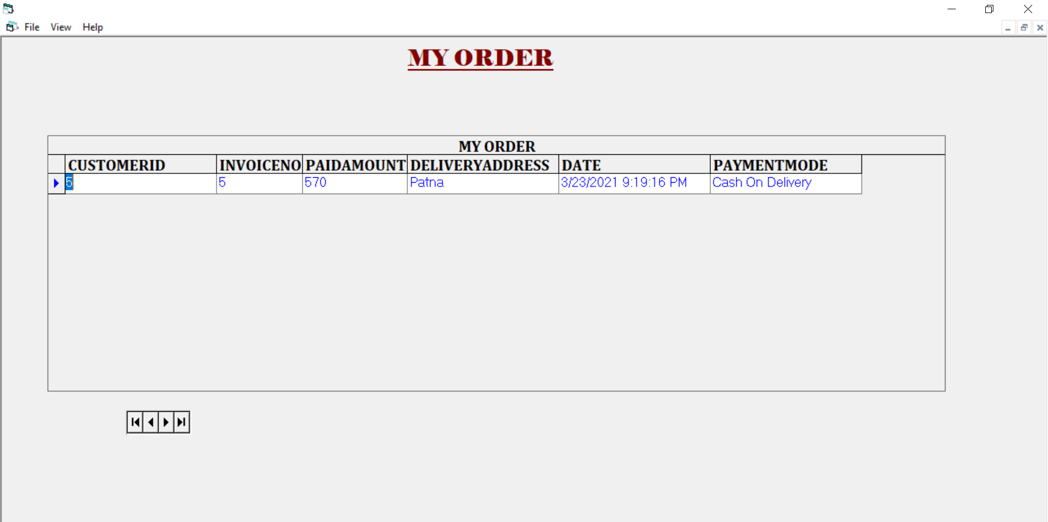
My Order Form
Electrical Store Management System
29

Slide 30
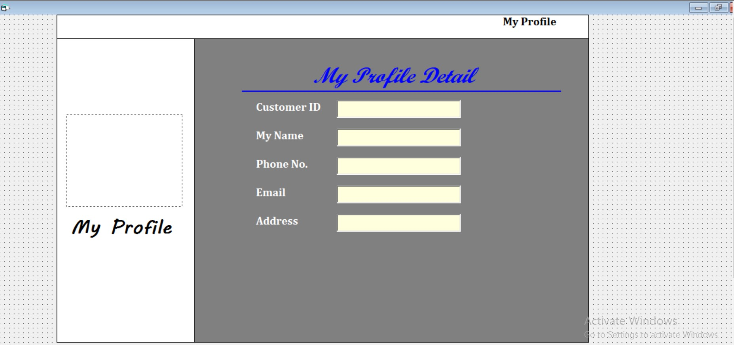
Customer Profile
Electrical Store Management System
30

Slide 31
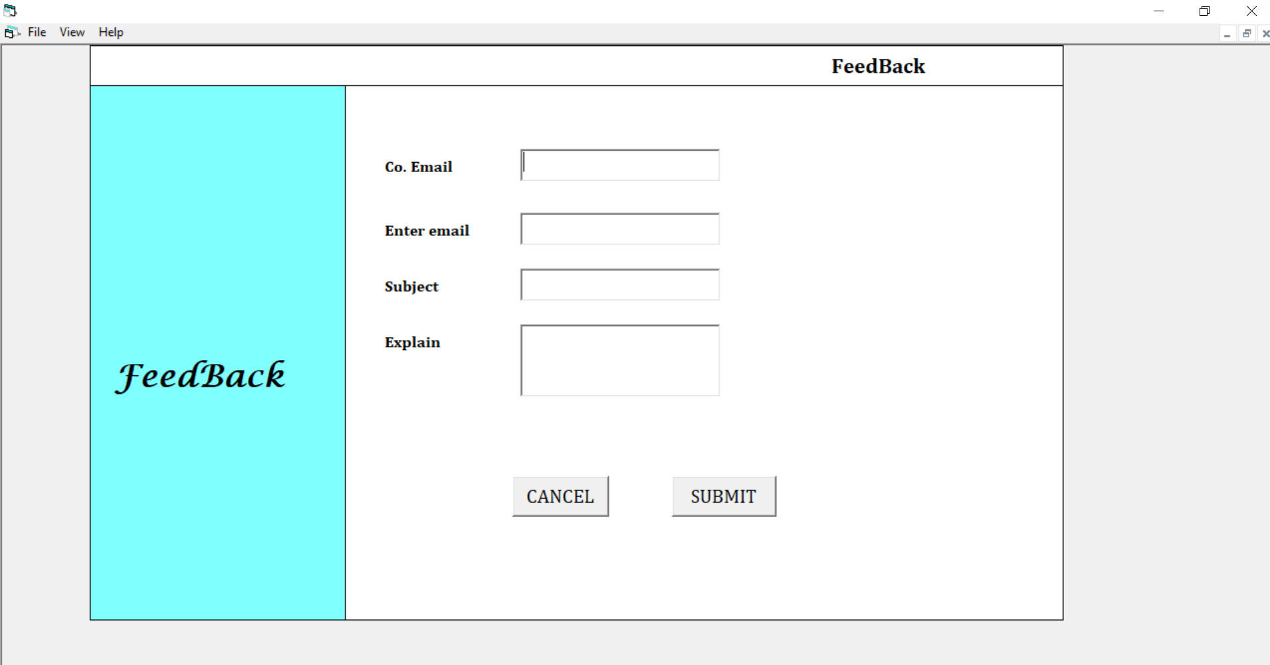
Feedback Form
Electrical Store Management System
31

Slide 32
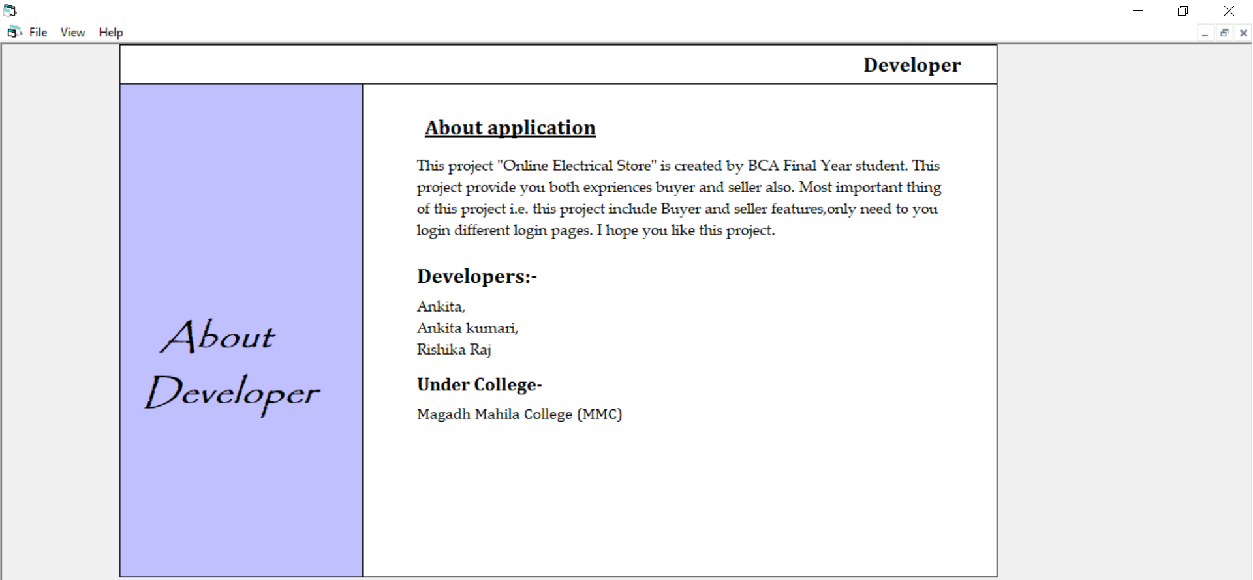
About Developer Form
Electrical Store Management System
32

Slide 33
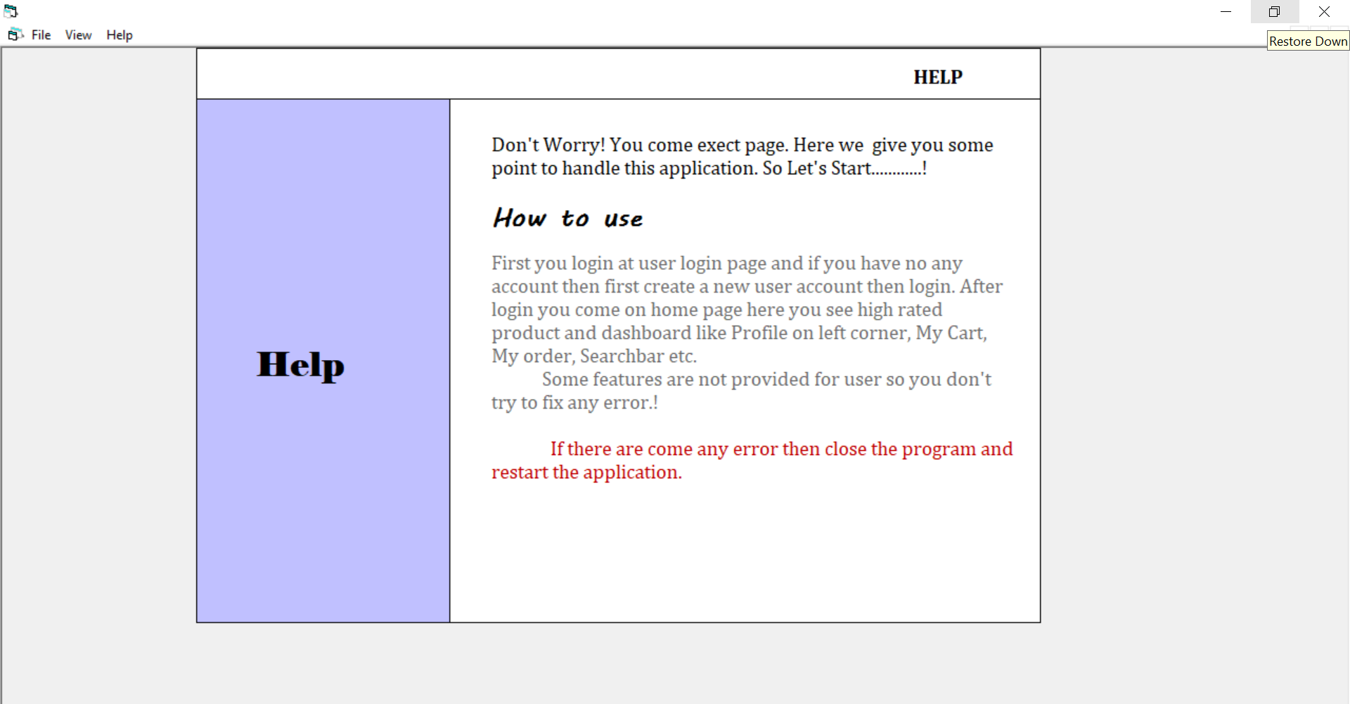
Help Form
Electrical Store Management System
33

Slide 34
9. Conclusion
The need for the Servicing After Sales system to computerize the application processing and servicing the customer’s request through automated modules is most necessary and now inevitable.
As we have already seen that the need cannot be emphasized for the further development of this system is only timely and helpful to store, the system defined in the above script is up to date and caters to all kinds of request faced by the store employees requirements to provide the better service to the customer, being developed by any other application because of its componentized approach. Based on the various parameters and properties files everything from the look and Feel to the functionalities can be customized.
Electrical Store Management System
34

Slide 35
10. Future scope
It helps to manage its day to day details of the customer order .
It helps to manage the details of customer ,customer order and tax invoices .
It gives the advantage to see the records of different modules on a single mouse click of mouse .
The record of different modules once entered in different databases will keep refreshing from the database.
The software is thus great use for preparation of reports on different modules (Customer , Customer Order , Employee , Product and Tax Invoice ).
Electrical Store Management System
35

Slide 36


